Slide 1

ENGINEERING MATHEMATICS-I
MATLAB
Department of Science and Humanities

Slide 2

Eigen values and Eigen vectors.
Syntax
e=eig(A)
[V,D]=eig(A)
[V,D,W]=eig(A)
e=eig(A,B)
[V,D]=eig(A,B)
[V,D,W]=eig(A,B)

Slide 3
Eigen values and Eigen vectors continued...
Description:
e= eig(A) returns a column vector containing the eigenvalues of square matrix A.
[V,D] = eig(A) returns diagonal matrix D of eigenvalues and matrix V whose columns are the corresponding right eigenvectors, so that A*V = V*D.

Slide 4
Eigen values and Eigen vectors continued...
[V,D,W] = eig(A) also returns full matrix W whose columns are the
corresponding left eigenvectors, so that W'*A = D*W'.
The eigenvalue problem is to determine the solution to the equation Av = λv, where A is an n-by-n matrix, v is a column vector of length n, and λ is a scalar.
The values of λ that satisfy the equation are the eigenvalues. The corresponding values of v that satisfy the equation are the right eigenvectors. The left eigenvectors, w, satisfy the equation w’A = λw’.
e = eig(A,B) returns a column vector containing the generalized eigenvalues of square matrices A and B.
[V,D] = eig(A,B) returns diagonal matrix D of generalized eigenvalues and full matrix V whose columns are the corresponding right eigenvectors, so that A*V = B*V*D.

Slide 5
Eigen values and Eigen vectors continued...
[V,D,W] = eig(A,B) also returns full matrix W whose columns are the
corresponding left eigenvectors, so that W'*A = D*W'*B.
The generalized eigenvalue problem is to determine the solution to
the equation Av = λBv, where A and B are n-by-n matrices, v is a
column vector of length n, and λ is a scalar.
The values of λ that satisfy the equation are the generalized eigenvalues.
The corresponding values of v are the generalized right eigenvectors.
The left eigenvectors, w, satisfy the equation w’A = λw’B.

Slide 6
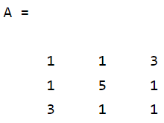
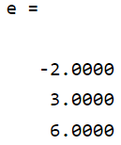
Eigen values and Eigen vectors continued...
Find the eigenvalues and the corresponding eigenvectors of the matrix A= [1,1,3;1,5,1;3,1,1].
>> A=[1,1,3;1,5,1;3,1,1]
>> e=eig(A)

Slide 7

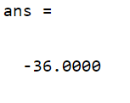

Eigen values and Eigen vectors continued...
>> det(A)
>> prod(eig(A))
Therefore, det(A)=prod(eig(A))
>> sum(eig(A))

Slide 8
Eigen values and Eigen vectors continued...
>> trace(A)
Therefore, sum(eig(A))=trace(A)

Slide 9
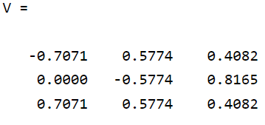
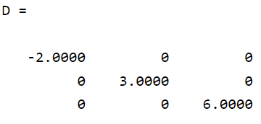
Eigen values and Eigen vectors continued...
Finding Eigenvectors of the matrix A:
>> [V,D]=eig(A)

Slide 10
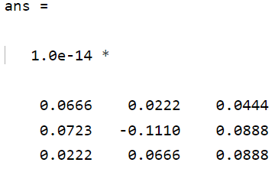
Eigen values and Eigen vectors continued...
Verify that V and D satisfy the equation, A*V = V*D
>> A*V-V*D
Ideally, the eigenvalue decomposition satisfies the relationship.
Since eig performs the decomposition using floating-point computations, then A*V can, at best, approach V*D. In other words, A*V - V*D is close to, but not exactly, 0.

Slide 11
Eigen values and Eigen vectors continued...
Note:
>> A*V(:,1) % This command will gives you First eigenvectore
>>D(1,1)*V(:,1) % First eigenvalue
If you replace 2 or 3 in place of 1, that will create second or third eigenvalue and eigenvectors respectively.

Slide 12
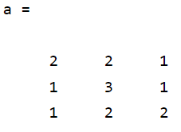
Eigen values and Eigen vectors continued...
Find the eigenvalue and eigenvectors of the matrix
A=[2,2,1;1,3,1;1,2,2] and B=[1,-1,1;1,0,0;-1,1,-1]
>> A=[2,2,1;1,3,1;1,2,2]
>>e=eig(A)
>>[V,D]=eig(A)
Output:
.

Slide 13
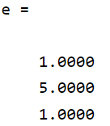
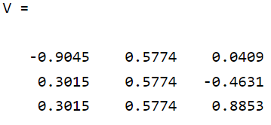
Eigen values and Eigen vectors continued...
Output:
.

Slide 14
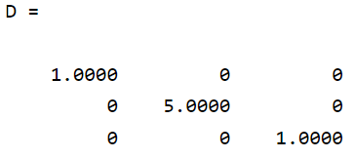
Eigen values and Eigen vectors continued...
.
.

Slide 15
Eigen values and Eigen vectors continued...
Problems:
Find the Eigenvalue and the corresponding Eigenvectors of
A=[1,-1,1;1,0,0;-1,1,-1].
Find the Eigenvalue and the corresponding Eigenvectors of
A=[1,3,1;4,1,3;2,1,3]
Find the Eigenvalue and the corresponding Eigenvectors of
A=[2,3,4;5,3,2;1,2,2]
.

Slide 16
THANK YOU

